Slide 1
Intelligent Robotic Arm to Pick and Place Target Objects
Group Members :
Omkar Mokashi
Raunak Sethiya
Taresh Tak
Mayur Jori
Guide Name
Prof. D. P. Salapurkar

Slide 2
Contents
Motivation
Idea Matrix
Literature Survey
Problem Statement
Scope of the System
Architecture Diagram
Modules of the System
Hardware and Software Requirements

Slide 3
Motivation
A mechanical robotic arm is used to perform many different tasks like picking and placing of objects repeatedly.
Robotic arm which is used to place target object coming on conveyer belt in manufacturing process is currently remote controlled.
There is a need to increase the efficiency of robotic arm by automation and reducing the resources including labor work and time consumed.
Improvisation in technology demands more accuracy and preciseness which needs to be addressed.

Slide 4
Idea Matrix
Idea | Implementation | Parameters affected
Increase | Reduces time of operation. Autonomous behavior in working. The stability of the system is increased | Performance Stability
Improve | Improved front end for operation. Movement mechanism of the robotic arm is improved. Automated system will improve efficiency. | Simplicity. Efficiency
Innovate | Hybrid algorithm for image processing. Learning mechanism. | Algorithm Learning Phase

Slide 5
Idea Matrix
Idea | Implementation | Parameters affected
Deliver | Autonomous Integrated System for object picking and placing. | Intelligent System
Decrease | Labour work required is reduced. The time required for the operation is decreased. | Human Load Time complexity
Educate | Project Members about inverse kinematics and Image Processing. | Knowledge
Evaluate | Time required to track target object. Path used to place objects. | Time Path

Slide 6
Idea Matrix
Idea | Implementation | Parameters affected
Eliminate | Risk human injury. Man power required. | Risk Labour
Accelerate | Processing of data and task completion time. Agility of manufacturing process. | Completion time. Manufacturing process.
Associate | Integration of embedded system with open source library and robotic arm. Robotic Arm in manufacturing process. | Automation. Assembly Line

Slide 7
Literature Survey
Year | Authors | Title | Seed Ideas | Pros | Cons
2017 | Adna Sento, Pannawit Srisuk, Yuttana Kitjaidure | An Intelligent System Architecture for Meal Assistant Robotic Arm | Feature extraction algorithm using the Microsoft Kinect sensor to create the target position in 3-dimensional Cartesian coordinate. Inverse kinematic algorithm to convert the Cartesian coordinate into the joint angles. Controller algorithm. The 4-joint robotic arm. To evaluate the performances, the Matlab program is used to implement the overall system. | Constraints for joint angle calculation is eliminated. Low time consumption for joint angle calculation. | Optimal path cannot be found in learning phase. Statical noise affects accuracy.
2017 | Han-Ul Kim, Chang-Su Kim | Locator-Checker-Scaler Object Tracking Using Spatially Ordered and Weighted Patch Descriptor | Spatially ordered and weighted patch (SOWP), to represent the appearance of an object faithfully and suppress background information in a bounding box systematically. LCS tracker, which incorporate the locator, the checker, and the scaler to achieve robust tracking | High precision result for low FPS. Interference around object is handled. | Deformation in object can’t be handled.
2015 | Shihabudheen KV, G N Pillai | Evolutionary fuzzy extreme learning machine for inverse kinematic modeling of robotic arms | Incorporating the concept of fuzzy logic into neural networks, Training algorithm of extreme learning machine, evolutionary extreme learning machine and evolutionary fuzzy extreme learning machine. EF-ELM to predict the inverse kinematic solution of the robotic arm. | Fast and accurate inverse kinematic prediction. | Not suitable for repetitive tasks.

Slide 8
Literature Survey (Cont..)
Year | Author | Title | Seed Ideas | Pros | Cons
2015 | Baochang Zhang, Zhigang Li, Alessandro Perina, Alessio Del Bue, Vittorio Murino, Jianzhuang Liu | Adaptive Local Movement Modeling (ALMM) for Robust Object Tracking | Part-based trackers for single object by dividing the image into local patches to track the moving object seamlessly. With the help of Spatio-Temporal Context, considering the output of base tracking algorithm, a Gaussian Mixture Model (GMM) is first used to model the distribution of the movement of local patches relative to the gravity center of the tracked object. Then, the GMM is combined with the chosen base tracker in a boosting framework, which gives an efficient integrated scheme for the tracking task. | Adaptive local movement modelling. Alleviate complexity situations including occlusions, severe textures variations, quick motions. | It uses only one appearance information. Industrial environment complexity
2014 | Muhammad Aziz Muslim, Saif Nura Urfin | Design of geometric based Inverse Kinematics for a low cost robotic arm | Effectively control end effector of a robotic manipulator. The inverse kinematic is based on triangulation method. The triangle always be able to formed by connecting two neighboring links with imaginary lines. | Relatively simpler to understand. It is applicable for multi joint arm. | More computation required to execute. Rotation of circle is restricted to quarter circle.

Slide 9
Problem Statement
To implement a front end software to operate Robotic arm with a camera vision to identify target object, pick the target object and place the object at its destination intelligently. Motion of the Robotic arm should be optimized. Manufacturing defect should be identified and defective objects should be spaced apart.

Slide 10
Scope of Project
The machine will be of great use to preform repetitive task of picking and placing of target objects (up to 2kg) in an industrial production line.
Camera vision of the robot will be used for tracking the target object.
Controlling the movement of the robotic arm.
Camera vision to identify the manufacturing defects.

Slide 11
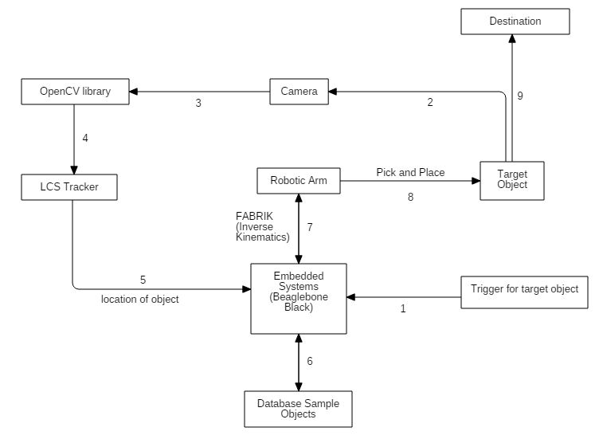
Architecture Diagram

Slide 12
Modules of the System
Mechanical arm
Inverse Kinematics (FABRIK Algorithm)
Optimal path calculation of the arm (Cubature Kalman filter algorithm)
Camera Vision
Object detection (SOWP Descriptor algorithm)
Object tracking (LCS Tracking Algorithm)
Fault detection (LCS Tracking Algorithm)

Slide 13
Requirements
Hardware
Robotic Arm: Provided by Indus Robotics
Camera (As provided by Indus Robotics)
Embedded system: Beaglebone Black
AM335x 1GHz ARM® Cortex-A8
512 MB DDR3 RAM
4GB 8-bit eMMC on-board flash storage
2x PRU 32-bit microcontrollers
Software and Platform
Operating System: Linux (Debian)
Programming Language: Python 3
Database: MySQL
Libraries: OpenCV 3.3

Slide 14
References
Adna Sento, Pannawit Srisuk, Yuttana Kitjaidure, An Intelligent System Architecture for Meal Assistant Robotic Arm, 2017
Han-Ul Kim; Chang-Su Kim, Locator-Checker-Scaler Object Tracking Using Spatially Ordered and Weighted Patch Descriptor, 2017
Shihabudheen KV, G N Pillai, Evolutionary fuzzy extreme learning machine for inverse kinematic modeling of robotic arms, 2015
Baochang Zhang, Zhigang Li, Alessandro Perina, Alessio Del Bue, Vittorio Murino, Jianzhuang Liu, Adaptive Local Movement Modeling (ALMM) for Robust Object Tracking, 2015
Muhammad Aziz Muslim, Saif Nura Urfin, Design of geometric based Inverse Kinematics for a low cost robotic arm, 2014

